Slide 1
Introduction to Decentralized Finance
Digital tokens and the functions of money

Slide 2
What is a digital token?
A digital token is an object that is stored and traded in digital form.
A more precise definition can be provided after classifying them in three categories:
Payment tokens: They are a form of digital currency that act as a medium of exchange and as a store of value. Mathematical properties and governance mechanisms are used to generate new units (supply) and verify the transfer of units.
Utility tokens: They enable their holders to interact with or gain utility from a platform. They are similar to those used in an amusement park. They can be used to receive well defined services.
Asset or security tokens: They are linked to and constitute an economic claim to a real-world asset. Security token holders are entitled to certain rights and privileges of the underlying property. An example of privileges is the payment of dividends, proceeds from the sale of the underlying asset, etc.
Payment tokens are the least regulated while security tokens tend to be the most regulated.

Slide 3
Tokenization
Process whereby the rights to a real-world asset are converted into a digital security that is housed, subdivided, and traded on a blockchain system.
Through this process, the ownership of the asset is digitally linked and tracked through the token.
Tokenization does not change the nature of the asset itself but rather enhances the way the ownership is tracked, managed and transferred.

Slide 4
Payment tokens

Slide 5
What is money?
Money is:
Any asset that is widely used and accepted as payment.

Slide 6
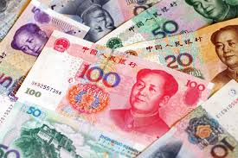

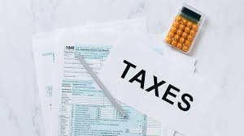
What are the functions of money?
Medium of exchange

Slide 7
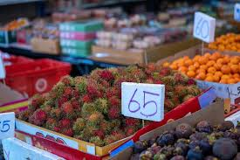
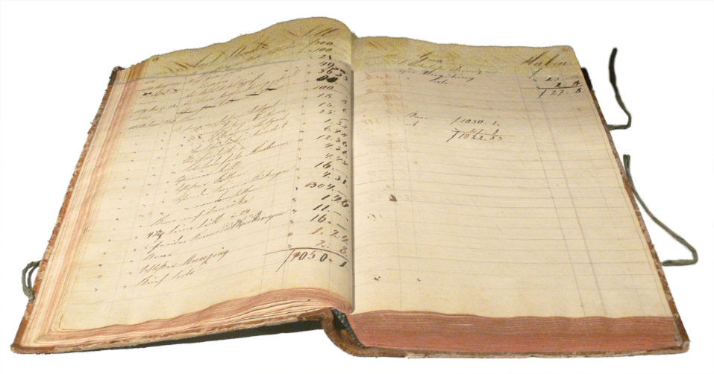
What are the functions of money?
Medium of exchange
Unit of account

Slide 8
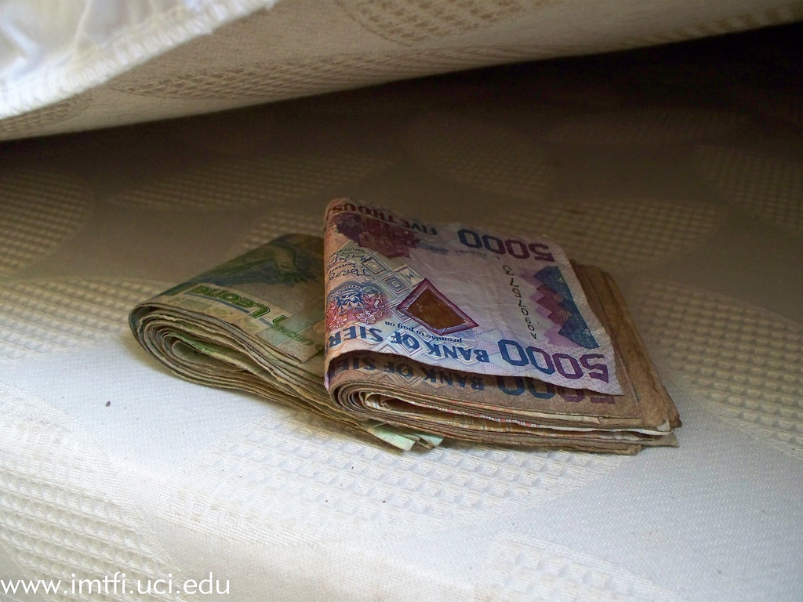
What are the functions of money?
Medium of exchange
Unit of account
Store of value

Slide 9
The market for “traditional” money
Supply of money
Money in circulation controlled by the central bank.
Demand for money
Money that the public would like to hold.

Slide 10

The quantity theory of money
$$M= k ∙ P ∙ Y$$
M = Money in circulation (supply)
k = Inverse of velocity of money
P = Nominal price
Y = Production

Slide 11
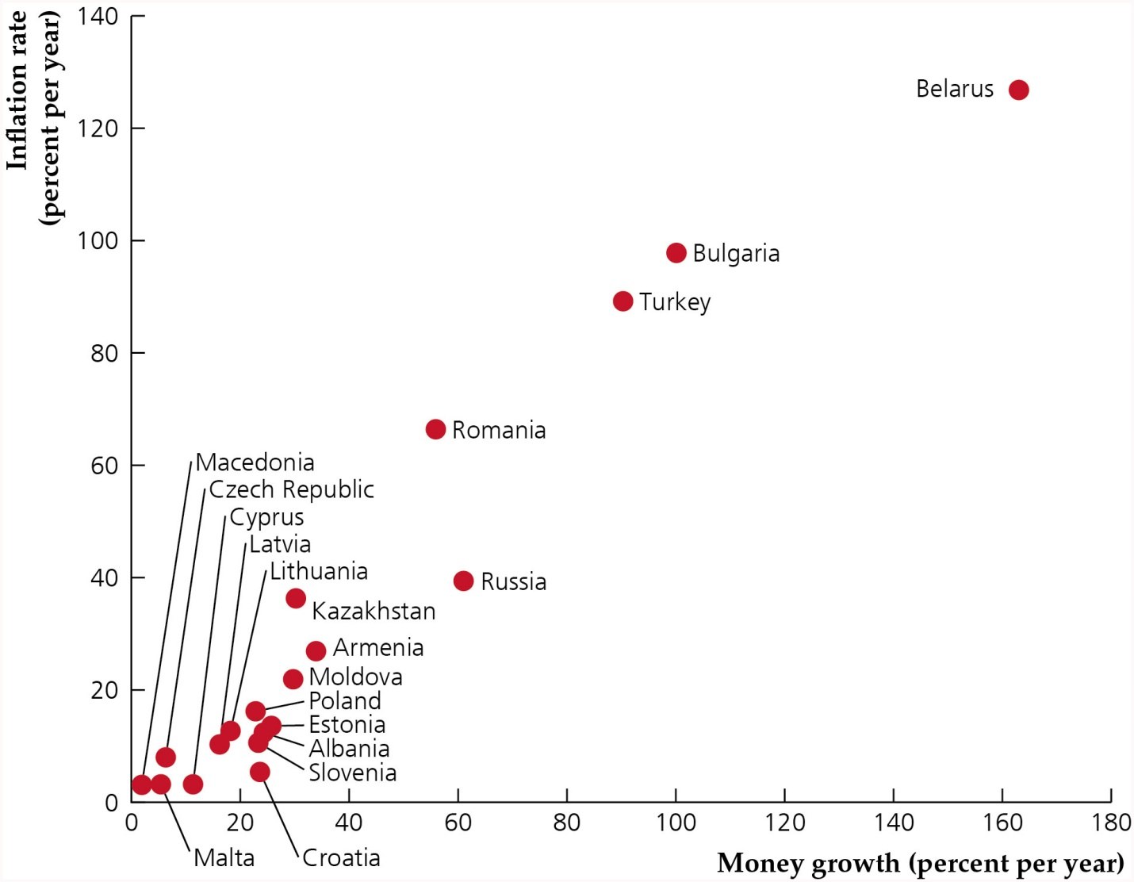
Money growth and inflation

Slide 12
Same principle applies to payment tokens
Scarce supply increases its value.
Similar to scarce commodities such as gold.
How can we make sure that the supply is scarce?
With national currencies this is guaranteed by the monetary authority (central bank).
Bitcoin platform has a governing system for which creating more bitcoins becomes more difficult as circulation increases.
As for precious metals, mining becomes more and more difficult (requires more computer processing to mine new bitcoins).

Slide 13
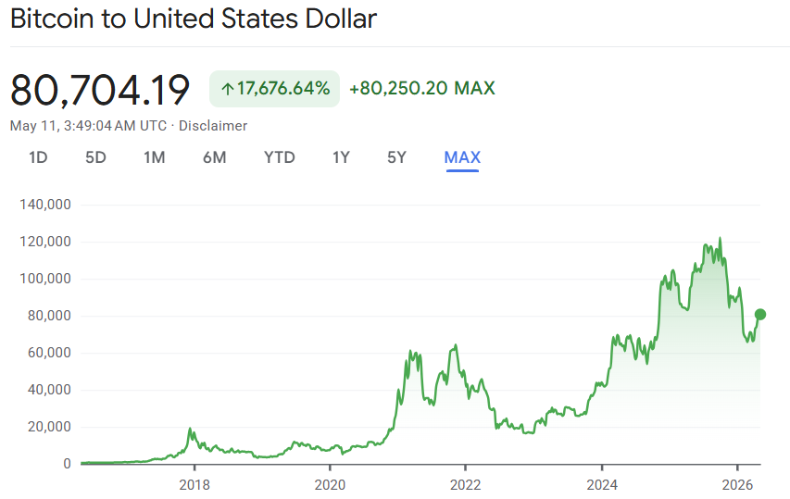
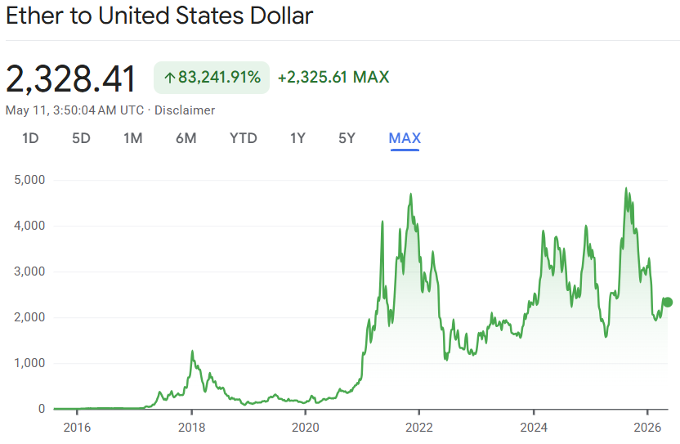
Problem: The value of cryptocurrencies is too volatile

Slide 14
What are stablecoins?
Cryptocurrencies designed to have reduced volatility as their price is linked to a “stable” asset. For example, the US dollar.
Many Stablecoins have redemption features for their underlying assets. They are said to be “backed” by these assets.
Most stablecoins have a controlling body that manages and monitors the underlying asset that serves as the peg for issued tokens.

Slide 15
How do stablecoins work? An example
Suppose that every token (stablecoin) in circulation is collateralized one-to-one with US Dollars.
The collateral is given by Dollars deposited in affiliated financial institutions. These reserves ensure that tokens are backed one-to-one with deposited cash.
A new stablecoin is created by an investor with the deposit of one dollar in an affiliated financial institution. In exchange of the dollar deposit, the investor receives one token (the stablecoin).
The financial institution will hold the deposit until the token is redeemed.
Tokens are burned when redeemed in exchange of the cash deposit.

Slide 16
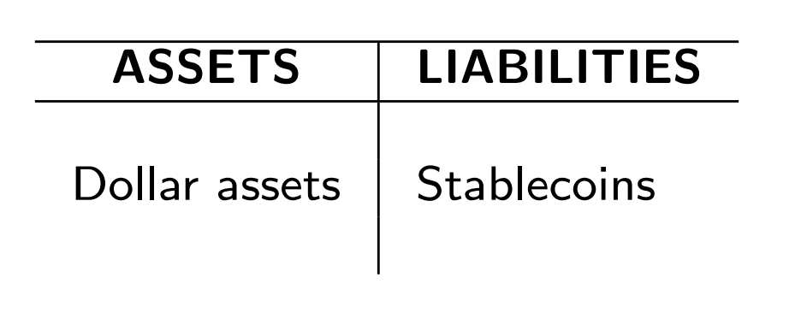
Balance sheet of affiliated financial institution

Slide 17
What guarantees that the price remains 1? Arbitrage
If market price is 95 cents, someone will buy at that price and redeem for 1 Dollar, making a profit of 5 cents. Because many will do that, the demand for stablecoins increases, raising the price back to 1 Dollar.
If the price is 1.05 Dollars, an investor can create a new stablecoin by depositing 1 Dollar and then immediately selling it at 1.05 Dollars. Because many will do that the supply of stablecoins increases, driving the price down to 1 Dollar.

Slide 18
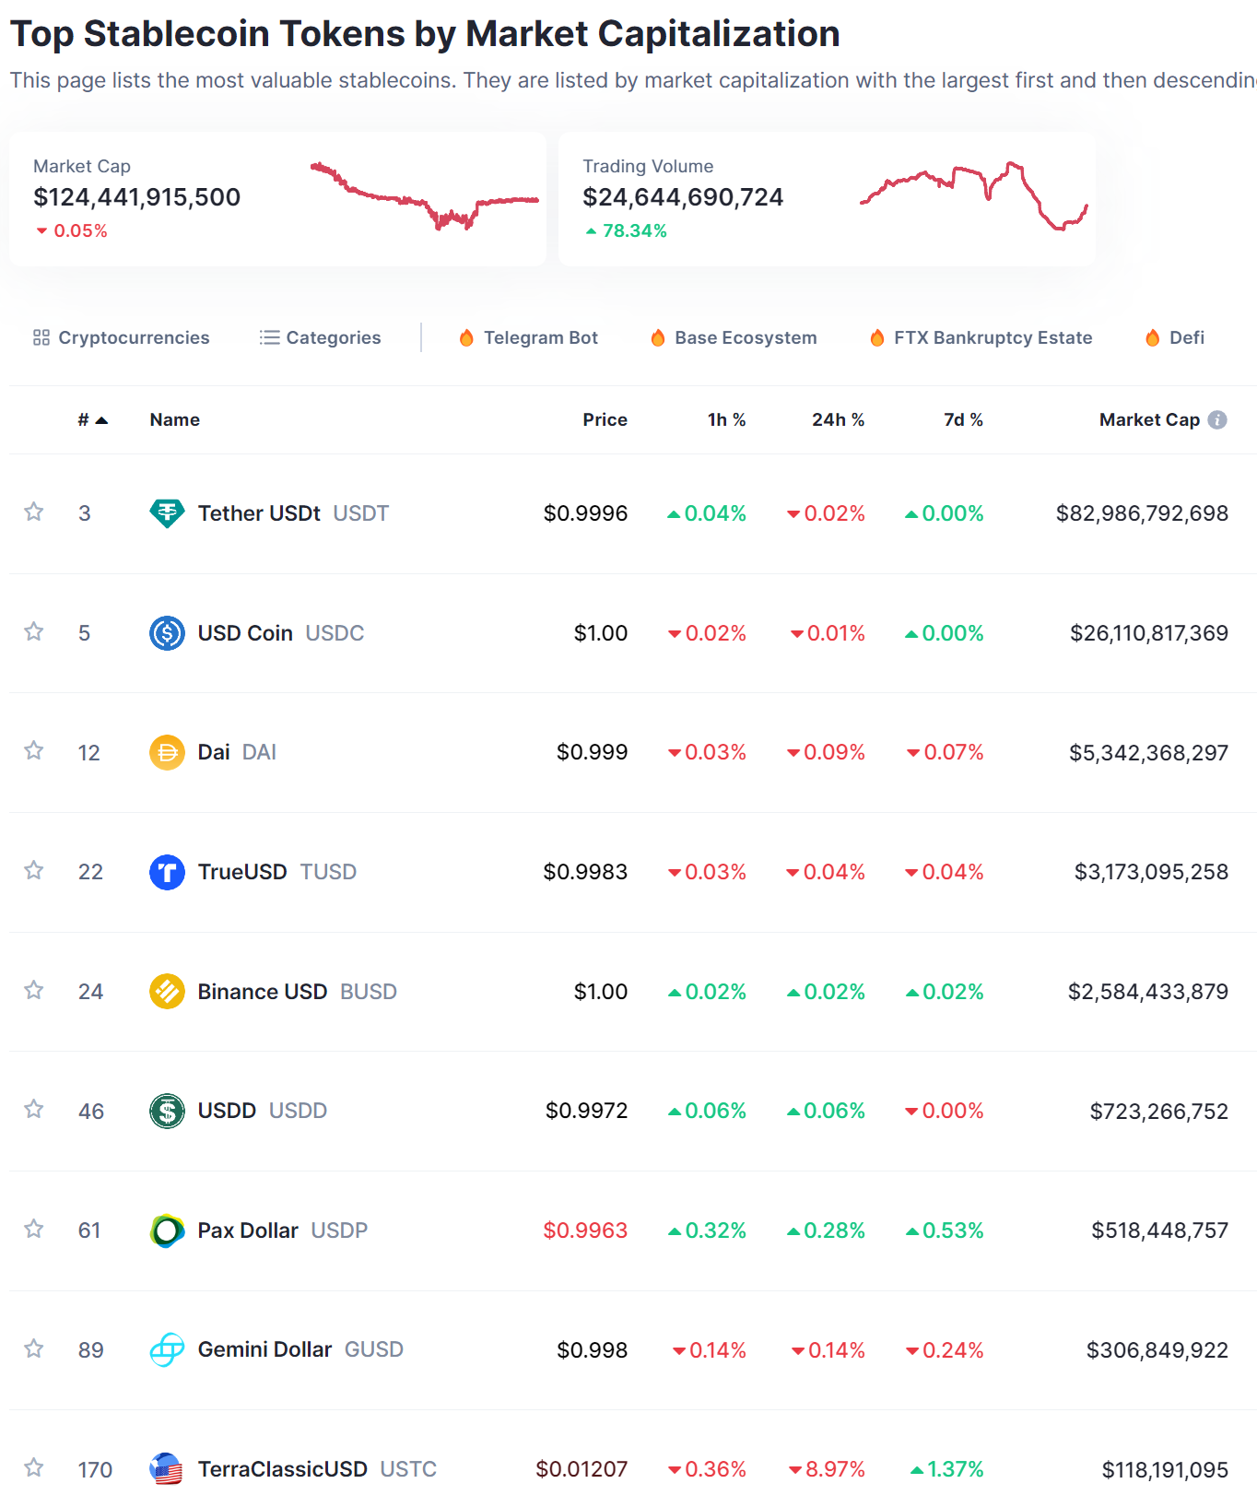
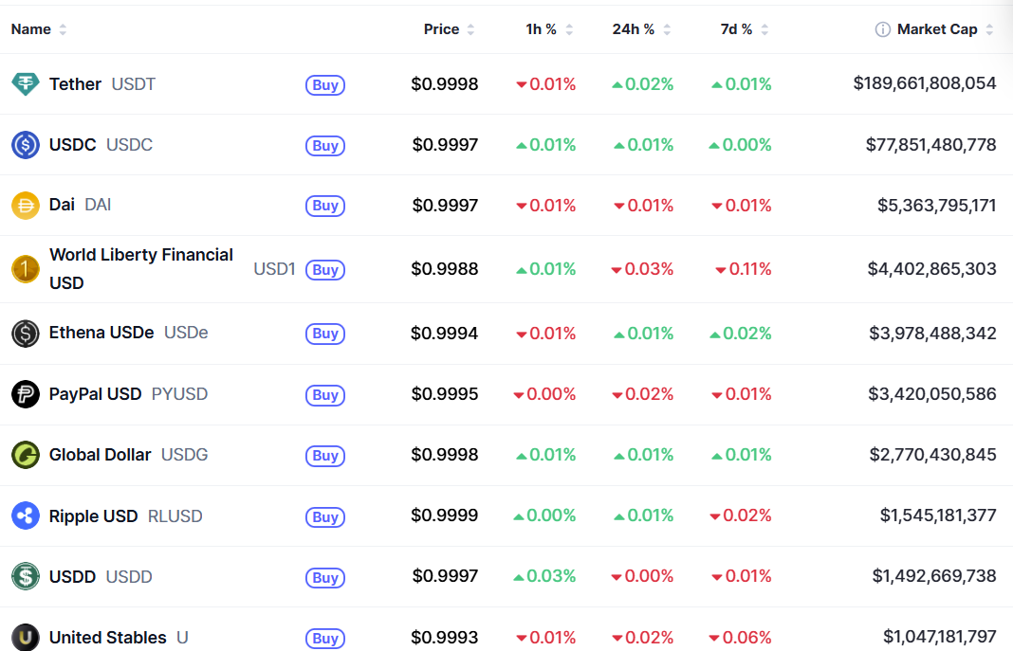

Slide 19
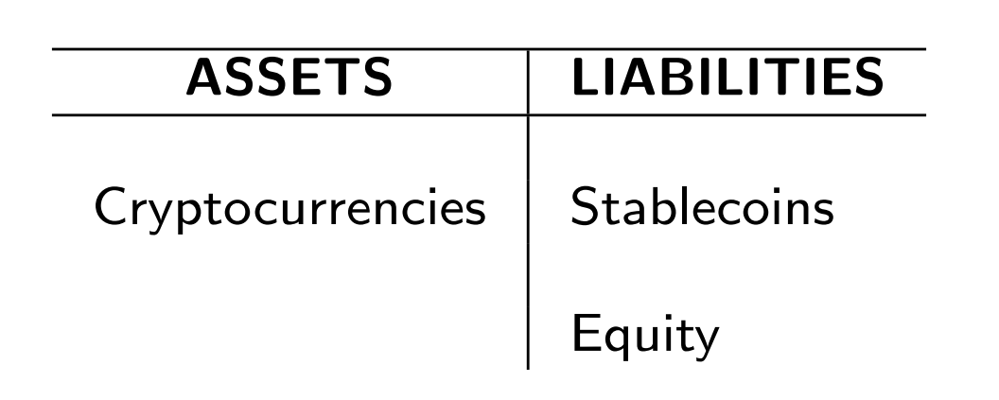
But the backing asset does not have to be the dollar

Slide 20
Stablecoins mechanism is similar to fixed exchange rate for a national currency

Slide 21
Foreign exchange market
Exchange rate is:
Price of one nation’s money in terms of another nation’s money.

Slide 22

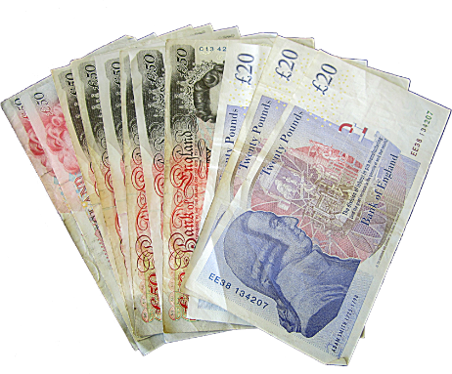
Example: US Dollars and British Pounds
Exchange rate = 1.2 Dollars/Pound
I pay 1.2 Dollars
I receive 1 Pound

Slide 23
How does the foreign exchange market work?
As any other market, the foreign exchange market is characterized by the interaction of demand and supply.
The price for the currency or foreign exchange rate equalizes demand and supply.

Slide 24
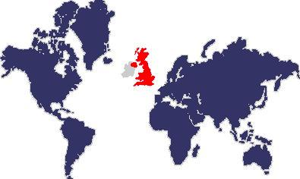

Demand for British Pounds, £
US payment
in Pounds
US Imports from UK; Purchases
of shares of UK businesses; etc.

Slide 25
Demand for Pounds (£) in exchange of Dollars ($)
$ per £
Billions of £

Slide 26
Supply of British Pounds, £
UK payments
in Dollars
UK Imports from US;
Purchases of US treasuries; etc.

Slide 27
Supply of Pounds (£) in exchange of Dollars ($)
$ per £
Billions of £

Slide 28
Demand and supply together
$ per £
S£
1.2
D£
300
Billions of £

Slide 29
Increase in the demand of Pounds
$ per £
S£
1.3
1.2
D£
300
320
Billions of £

Slide 30
Increase in the supply of Pounds
$ per £
S£
1.2
1.1
D£
300
320
Billions of £

Slide 31
Policy regimes for the exchange rate
Floating or flexible exchange rates
Policy authorities do not intervene systematically in the market to affect the exchange rate.
Fixed exchange rates
Policy authorities stand ready to purchase or sell foreign currency in order to balance the demand and supply at the targeted (fixed) exchange rate.

Slide 32
Defending a fixed exchange rate from depreciation
(peg Dollar/Pound)
Dollars for
1 Pound
S_{Pound} after intervention
S_{Pound}
1.2
D_{Pound}
17
20
Billions of Pounds
Bank of England purchases 3 Billions Pounds (and sells 3.6 Billion Dollars)

Slide 33
Where does the monetary authority get the foreign currency to intervene?
The monetary authority owns assets in foreign currencies (foreign reserves).
If countries are short of foreign reserves, they can borrow from other countries or international institutions.

Slide 34
Who owns
foreign
reserves?

Slide 35
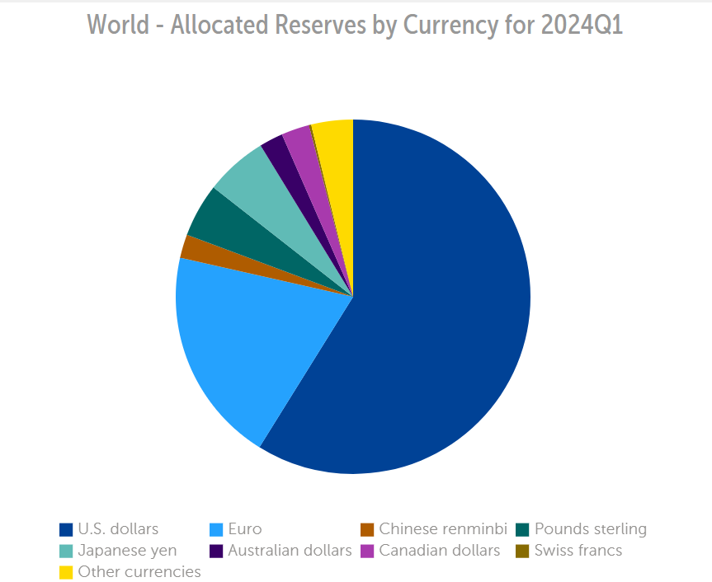
In what
currencies?

Slide 36
Inflation rate

Slide 37
Peso depreciation
Inflation rate
Currency board
1991-2001

Slide 38
A similar mechanism operates with stablecoins
The governing body of a stablecoin is the equivalent of a monetary authority.
The governing body has control over assets they can use to maintain the stability of the coin (reserves).
If there is shortage of liquid reserves, liquidity can be increased by borrowing.

Slide 39
Stablecoins
They are cryptocurrencies designed to have reduced volatility as their price is often linked to a stated “stable” asset or basked of assets.
In some cases, stablecoins are pegged to fiat money (for example US Dollars) or commodities.
Most stablecoins have a controlling body that manages and monitors the underlying asset that serves as the peg for issued tokens.
Reserves are kept and used to stabilize the price of the coin.

Slide 40
Defending the peg for Tether
(The case of “Burning existing Tether”)
Dollars for
1 Tether
S_{Tether} after intervention
S_{Tether}
1
D_{Tether}
4
7
Million of Tether
Governing body
redeems (burns)
3 Millions Tether

Slide 41
Defending the peg for Tether
(The case of “Minting new Tether”)
Dollars for
1 Tether
S_{Tether}
S_{Tether} after intervention
1
D_{Tether}
7
10
Millions of Tether
Arbitragers
mint
3 Millions Tether

Slide 42
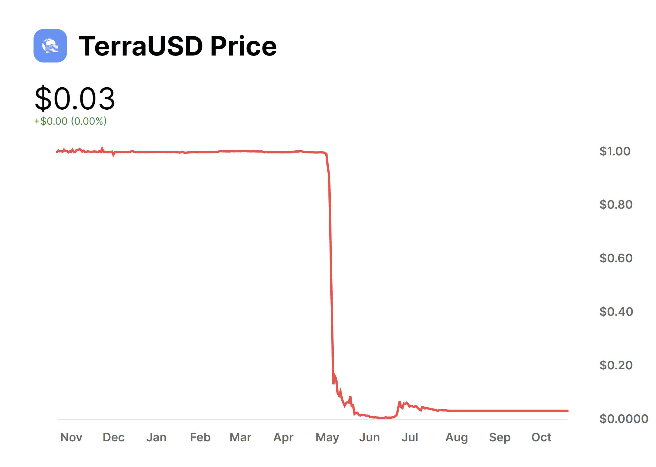

Slide 43
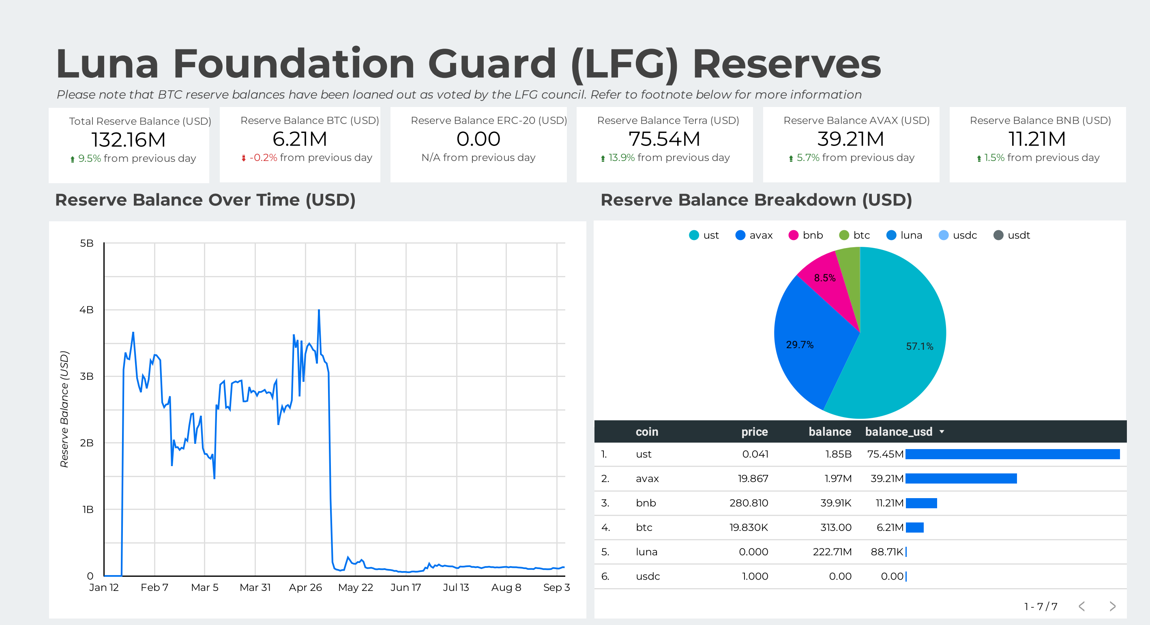

Slide 44
Growing interest in stablecoins

Slide 45
GENIUS Act Guiding and Establishing National Innovation for US Stablecoins
Legal framework that regulates the issuance of stablecoins by banks and fintech companies.
Signed into law on July 18, 2025.
Key features:
Stablecoins must be fully backed 1-to-1 by U.S. dollars or equivalent safe assets.
Regular audits and reports to prevent fraud and protect consumers.
Creates a dual oversight system: role played by both federal and state regulators.
Goals: (i) ensure stability in the crypto market; (ii) protect investors; (iii) strengthen U.S. leadership in digital finance.

Slide 46
Hong Kong Stablecoins Regulation
Hong Kong introduced recently a licensing framework for any entity issuing a stablecoin in Hong Kong backed by the Hong Kong dollar.
Passed on May 21, 2025. Became effective on August 1, 2025.
Key features:
Stablecoins must be fully backed by high-quality, liquid reserves held in trust and redeemable at par.
Issuers need strong risk management and internal controls.
Enforcement of disclosure and governance obligations.

Slide 47
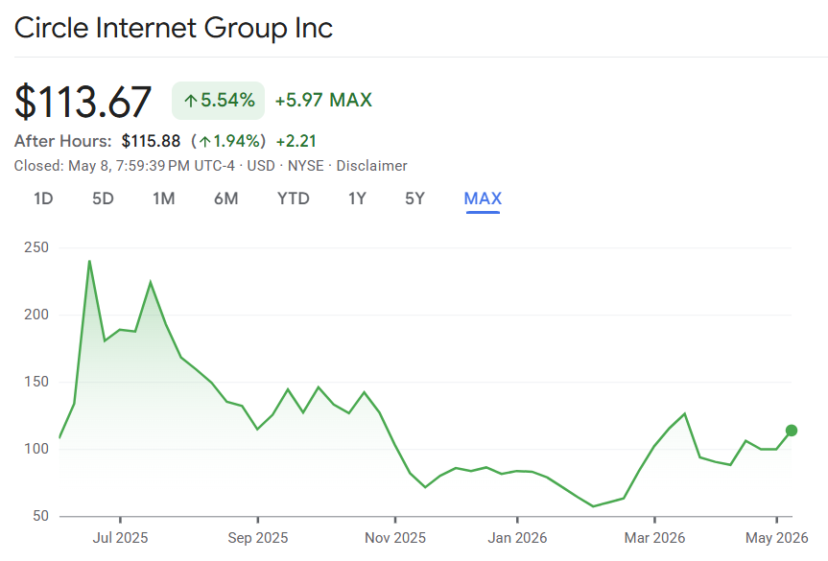
Circle Internet Group
Public Company: Trading in NYSE starting in June 5, 2025.
Core Business: Peer-to-peer payments technology. USDC stablecoin is its flagship product.
Revenue Source: Primarily interests earned from reserves backing USDC. In 2024, most of the revenues ($1.68 billion) came from income earned on reserves.

Slide 48
Expansion of stablecoins and the international standing of the US Dollar

Slide 49
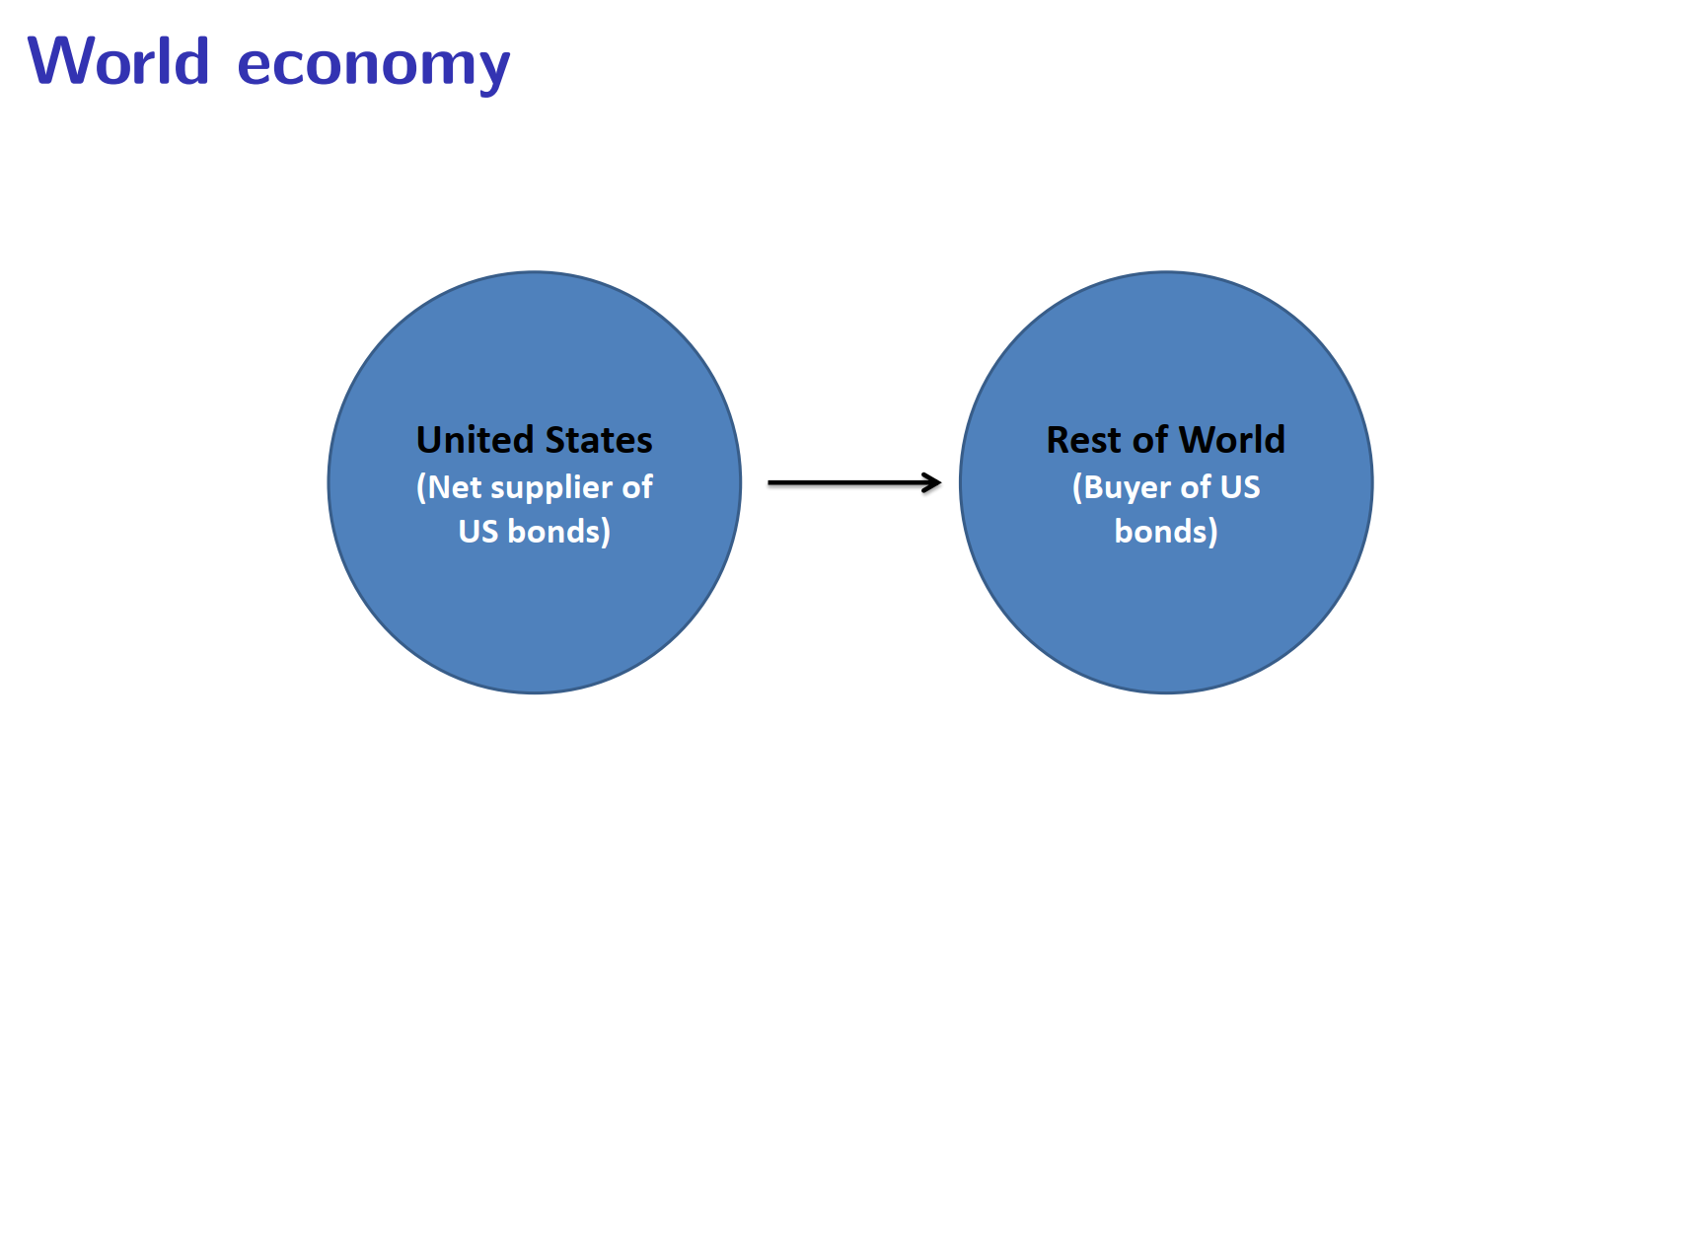

Slide 50
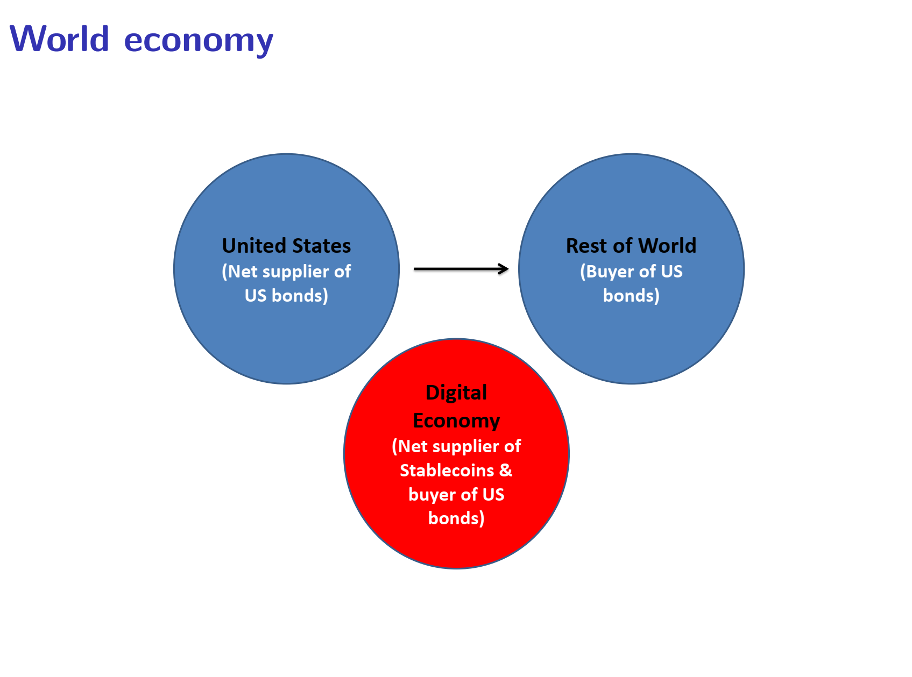

Slide 51
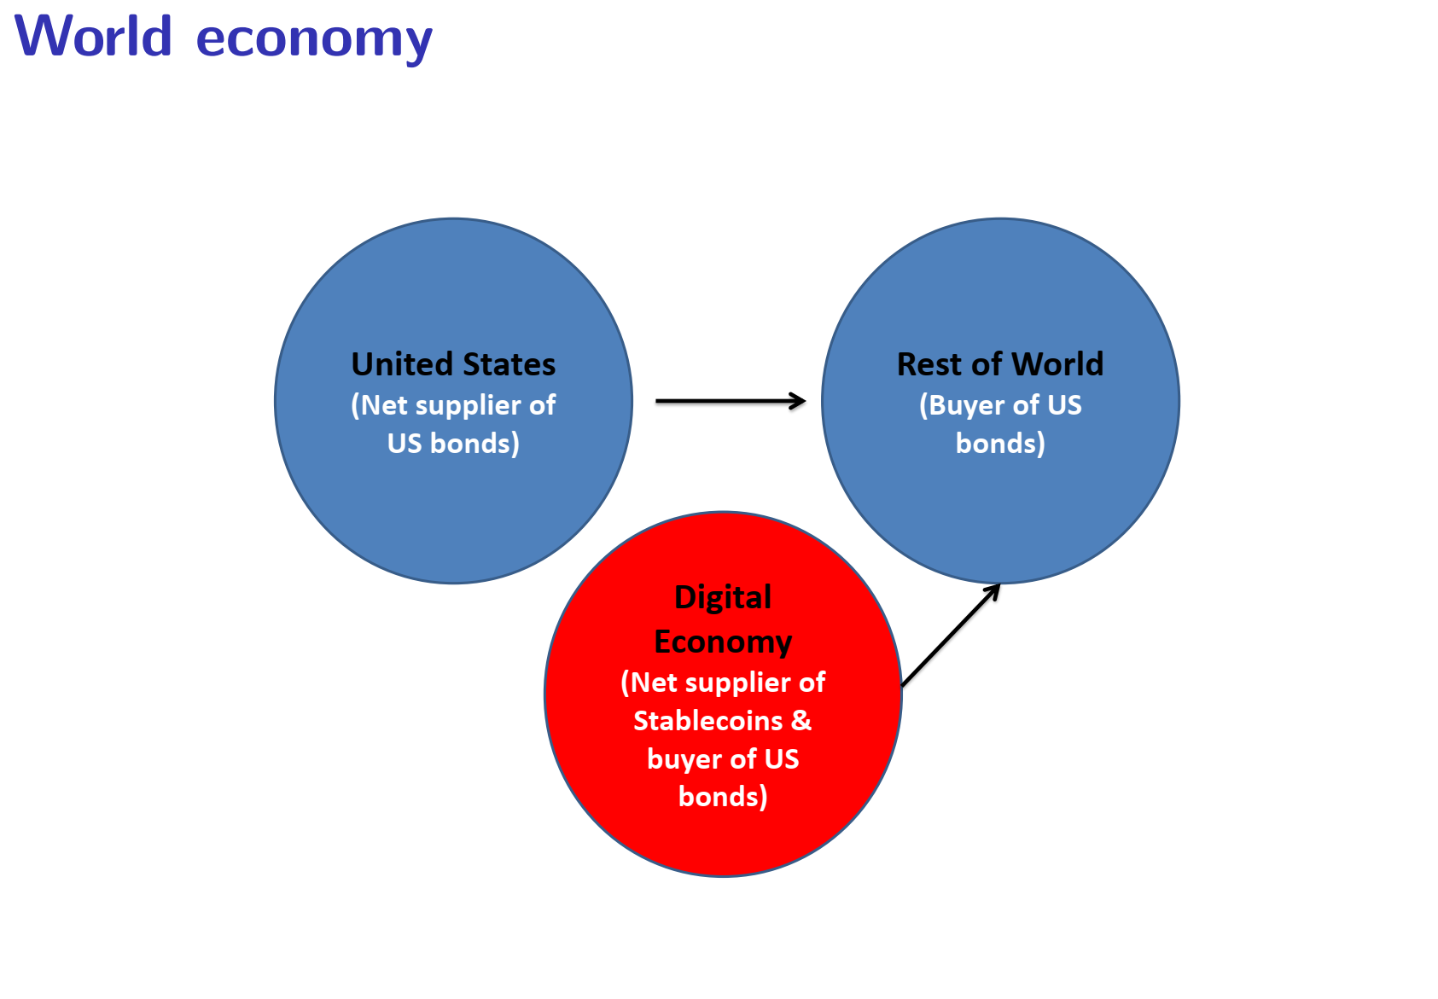

Slide 52
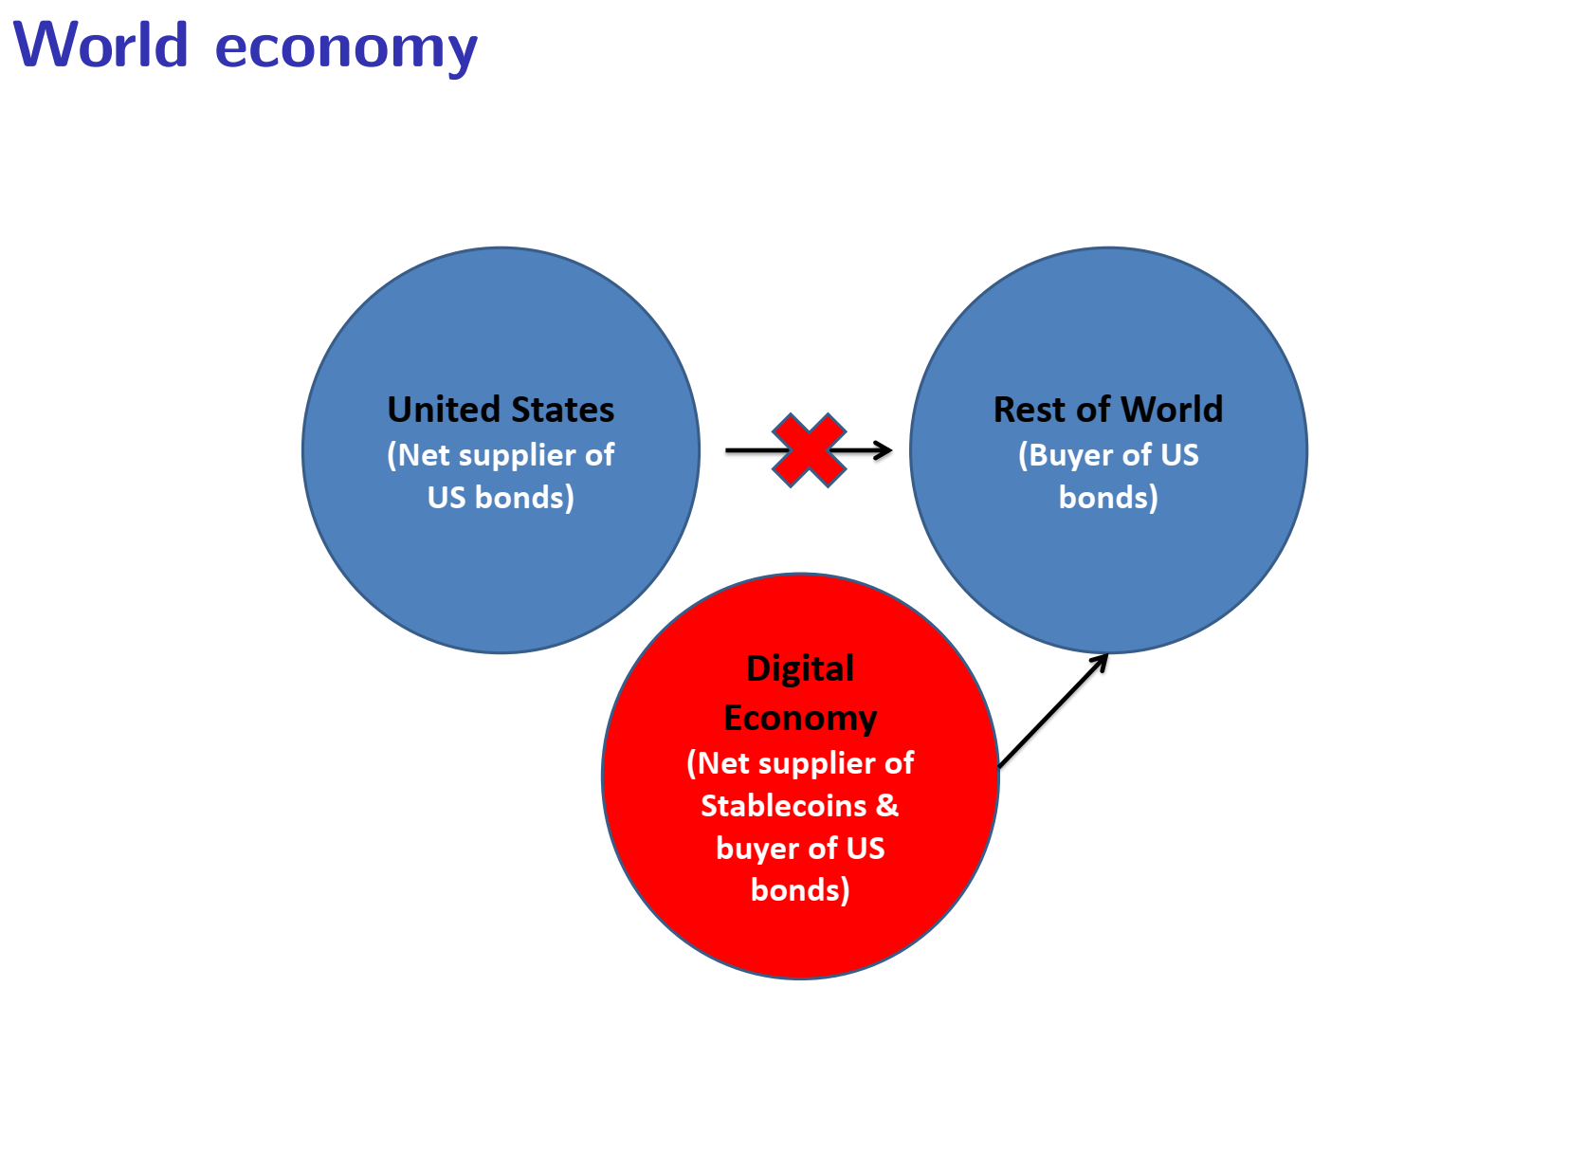

Slide 53
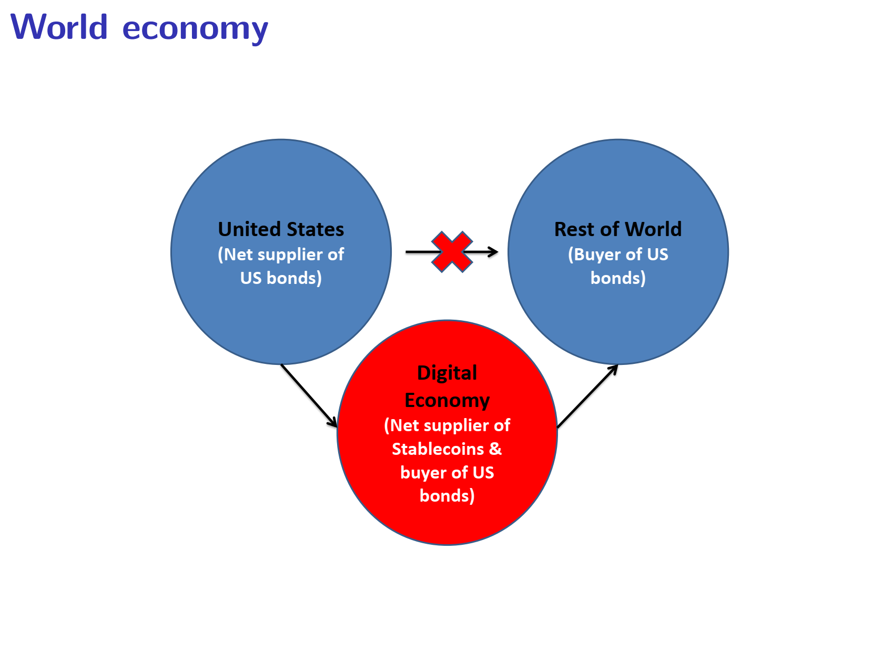

Slide 54
Case study: libra
In 2019 Facebook designed a digital payment token called “libra”.
Libra was based on the same principles as a stablecoin: The funds paid to buy a new libra will be placed into a bank deposit or other cash equivalent.
What was different (compared to Tether, USDCoins, etc.)?
Libra was not pegged to one currency (for example, the US dollar).
It was pegged to the value of a “basket” containing financial instruments denominated in many different currencies.
The libra project received objections from regulators in Europe, China, the US, and other countries with concerns about money laundering, customer protections, and the credibility of a tech company like Facebook to manage the massive financial-based undertaking.

Slide 55
Case study: libra (continue)
The value of the libra would fluctuate as the values of the underlying assets backing the libra fluctuate. This creates many problems. Example:
I buy 100 libra today for $120
Four days later I use the 100 libra to pay a meal in a restaurant. However, at that point the value has increased to $130.
For the tax authority I made a profit of $10 which should be taxed.
This is not different from other securities like the purchase of Amazon shares. However, it creates an accounting, reporting, and tax nightmare for anyone who touches it.
Another problem is that, by maintaining a pool of various assets to sustain the value of the libra, Facebook would effectively run a money market fund. Money market funds are subject to several regulations and compliance.
Also, what would happen in the eventuality of a market panic when the funds cannot meet redemption requests? Some government agency must step in, and the taxpayer would ultimately pay the cost.

Slide 56
Asset-Backet Tokens
Constitute the economic rights to real-world assets like commodities, art, real estate, or infrastructure projects.
The assets that are underlying the token are held in the form of a trust, by a custodian or by the entity promoting the token.

Slide 57
Fixed Income, Equity, and Funds Tokens
Bond-Like Tokens: They are backed by debt instruments and constitute a claim on its income streams and principal payments. They are relatively easy to automate with the use of smart contracts.
Share-Like Tokens: They provide ownership-like features that grant stakes in entities like a corporation or limited partnership. They can offer dividends, profit shares, or other interests in the entity. They also enable the holders to voting rights and other privileges.
Project-Funding Tokens: Designed to fund a particular project or investment. The payout could depend on the performance of the project or investment.

Slide 58
National digital currency

Slide 59
What is a national digital currency?
It is a currency that exists in digital form, created and controlled by a nation.
The main difference with cryptocurrencies is that the system is not decentralized. It is managed and controlled by the national authority (central bank).
National digital currencies is the response of governments to the competition from cryptocurrencies.

